Slide 1
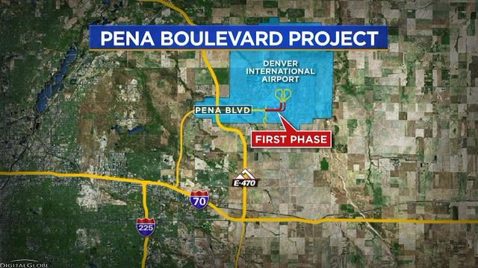
Interpreting Public Engagement Comments for Transportation Projects using Natural Language Processing

Slide 2
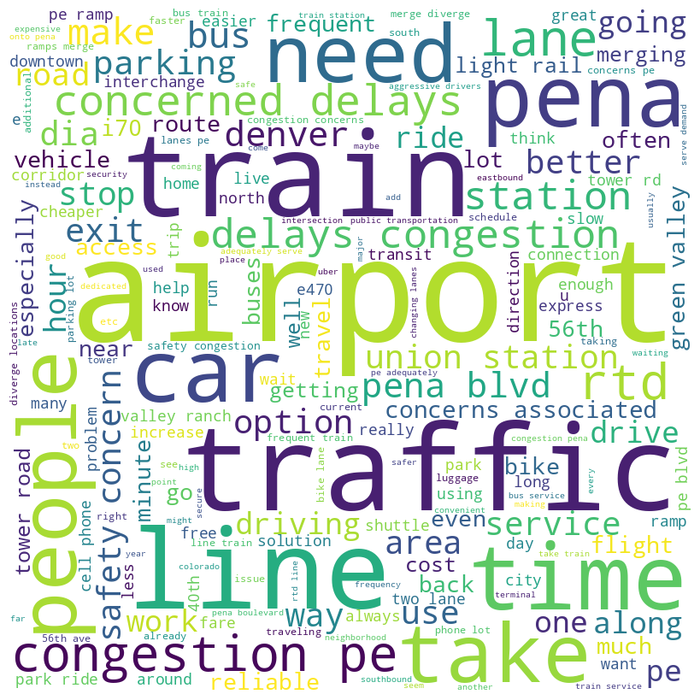
Emails
Public Comments

Slide 3
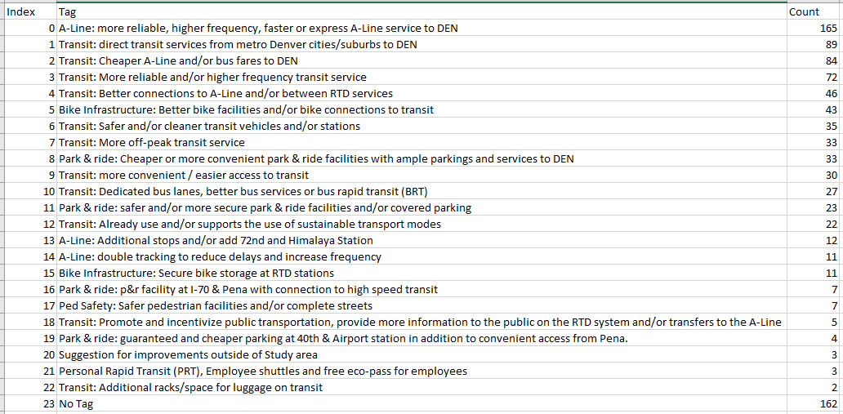

Slide 4
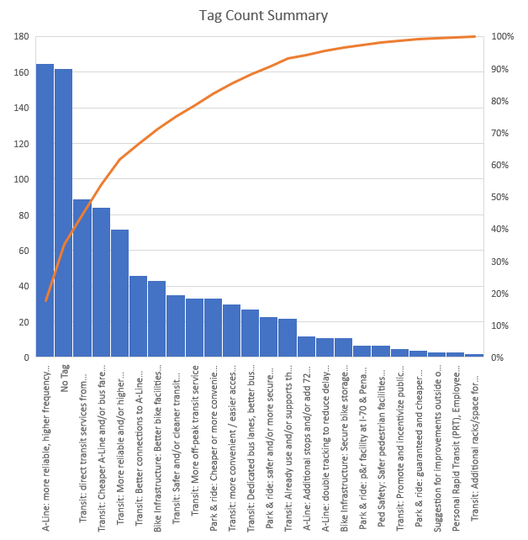

Slide 5

Embedding
Comment Sentence
Remove Stopwords
Remove html tags
Remove special characters
Filtered Comment Words
(trained using comment dictionary of our data)
Set of vector representations of Comment words
Cluster population as vector
Comment Vector

Slide 6
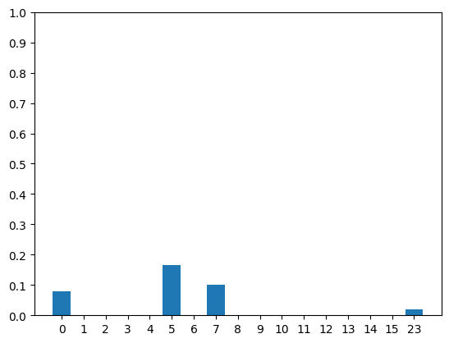
Baseline 1: Find cosine similarity between Tag text and comment to Tag
Recall
Tag ID

Slide 7
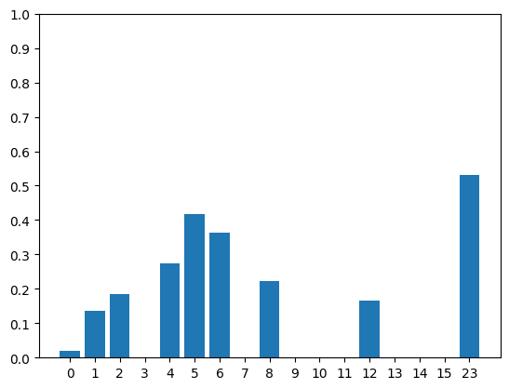
Baseline 2: Find cosine similarity between Average Comments per Tag and test-set comment
Recall
Tag ID

Slide 8

My Approach
# 1: Embed using
#2: Get comment summary using and then embed with

Slide 9
Issues
Too many classifiers with low population
The classifications blend among each other
Binary classifier have huge imbalance in 0s and 1s

Slide 10
Solution
Using one layer of classifier to classify some category of classes
Over sampling to tackle imbalance

Slide 11
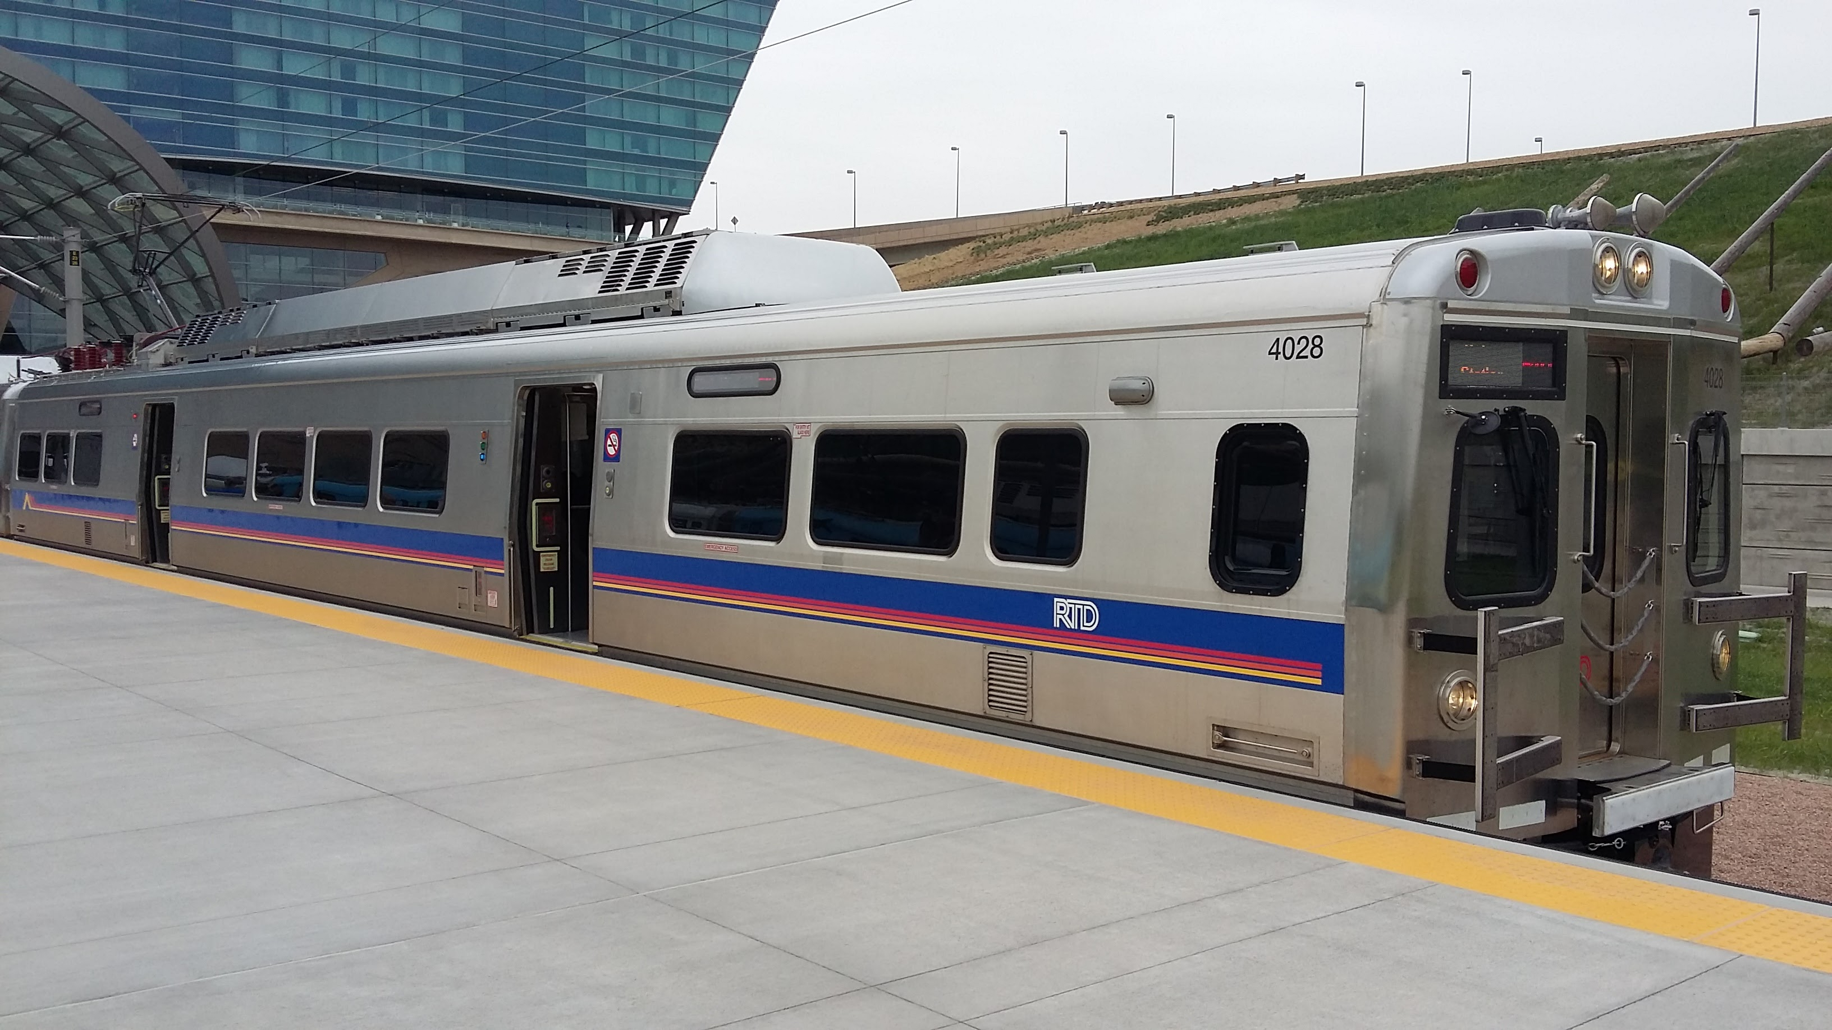



Solution (continued): Mode Choice
XG Boost
XG Boost
Comment
Individual Binary Classifiers
k-NN
SVM
k-NN
Neural Networks
XG Boost
Naïve Bayes
XG Boost

Slide 12
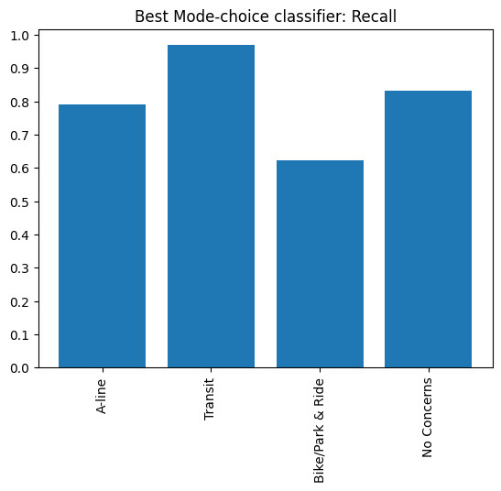
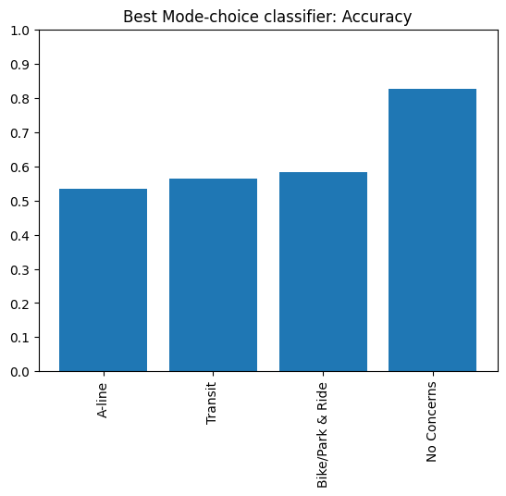
Solution (continued): Mode Choice

Slide 13

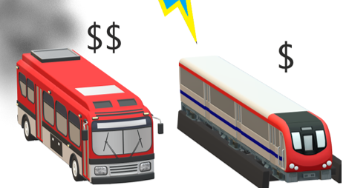

Results: Focus on Transit Sentiments
SVM
Comment
SVM
k-NN
Neural Networks
XG Boost
Naïve Bayes
Connection to the city
k-NN
SVM
Not about Transit
Cheaper mode

Slide 14
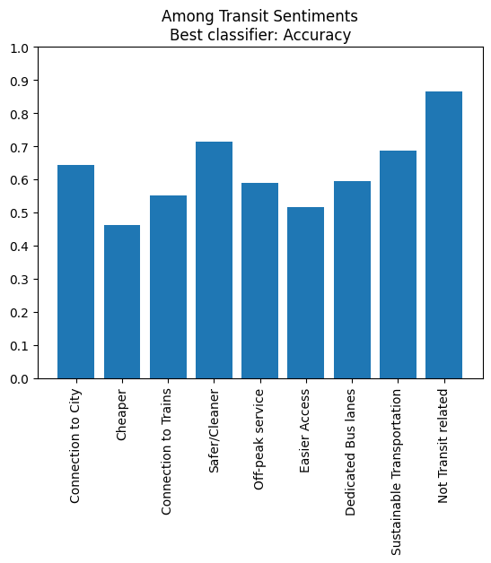
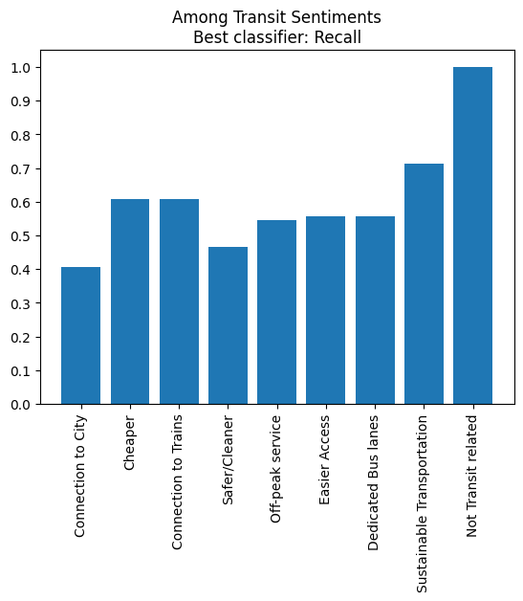
Final Model Results

Slide 15
Future Improvements
A lot of comments were unclear about the needs
More directed survey would help
Using LLMs to get executive summaries may suffice compared to the needs of the project.
Having more rounds of engagement will give more data to train models with, making the models more robust.

